Slide 1





Telco Customer Churn
Analysis
Supervised By: Dr.Doaa Mahmoud

Slide 2


Agenda
01
02
03
Introduction
Exploratory Data Analysis (EDA )
Business Insights
04
05
Conclusions
Recommendations

Slide 3




01
Introduction

Slide 4



Problem Statement
High customer churn rate impacting revenue.
Need to understand customer behavior to improve retention.

Slide 5



Objective
Analyze customer demographics and usage patterns.
Identify key factors influencing customer churn.
Develop targeted retention strategies.

Slide 6
02
Exploratory Data Analysis (EDA )

Slide 7



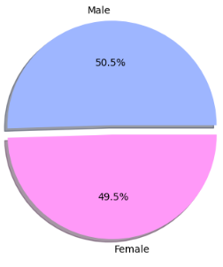
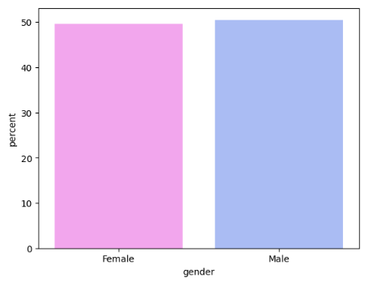
50.5%
49.5%
the ratio between males and females in our company

Slide 8
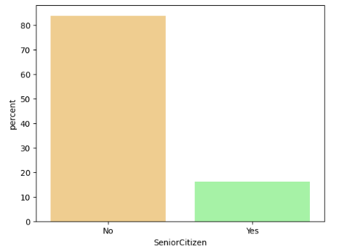
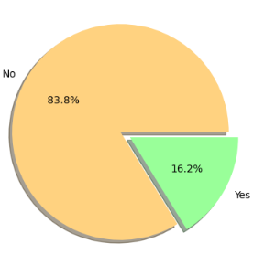
yes - > the customer is 65 or older
No -> the customer is less than 65
the ratio between Senior Citizens and others in our company?

Slide 9
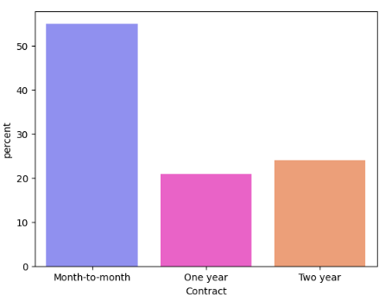
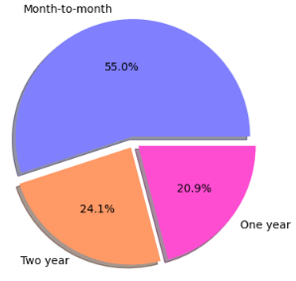
our Contract types we provide

Slide 10
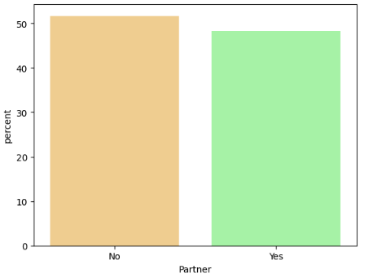
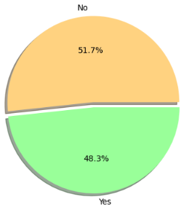
the ratio between who has partners and not in our company

Slide 11
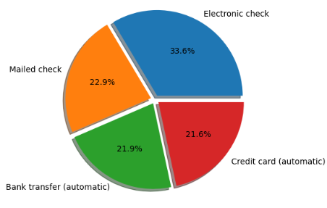
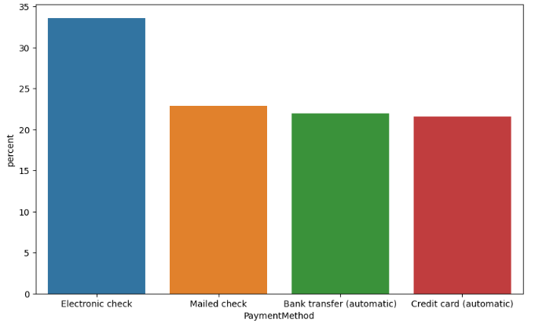
how many payment methods we provide? and what is the ratio between each others?

Slide 12
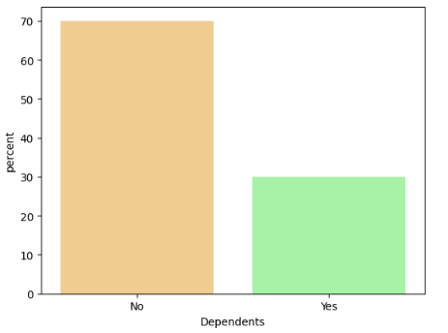
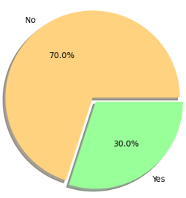
the ratio between who has dependents and not in our company

Slide 13
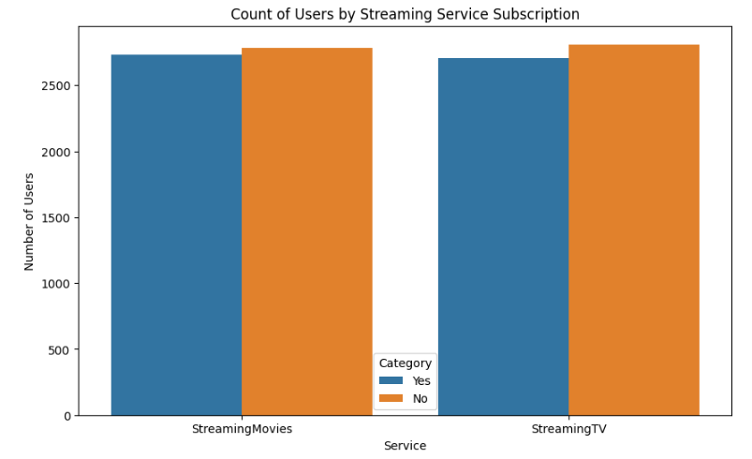
The ratio between users who streaming movies to StreamingTV subscribers

Slide 14
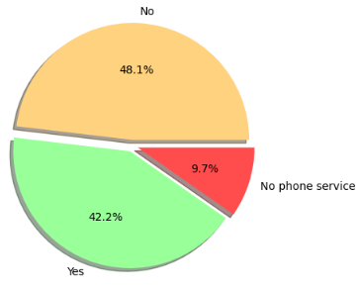
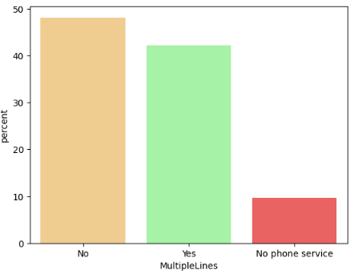
the ratio between who has MultipleLines and not in our company

Slide 15
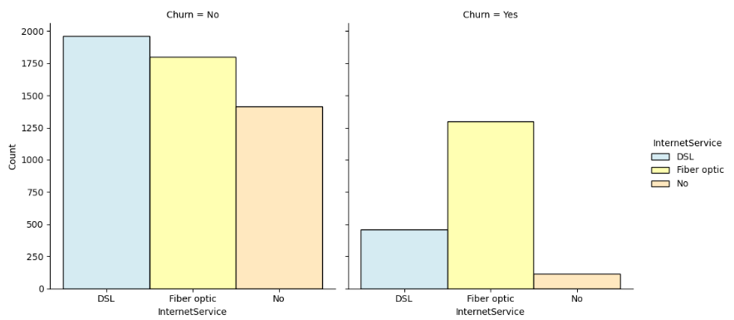
the relationship between the Internet Services and the churn rate

Slide 16
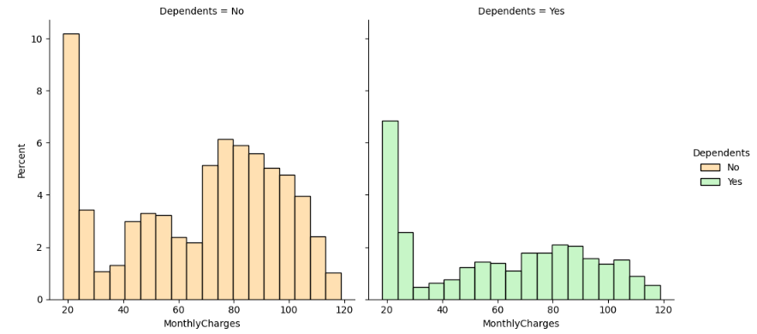
Is there a strong relationship between the monthly recharge rate and the dependents?

Slide 17
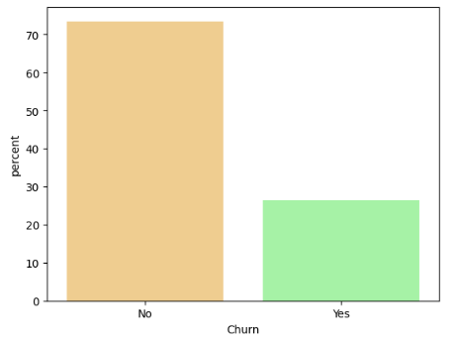
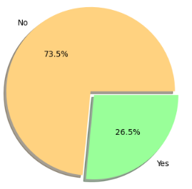
yes -> the customer left the company
No -> the customer remained with company
what is our churn rate?

Slide 18
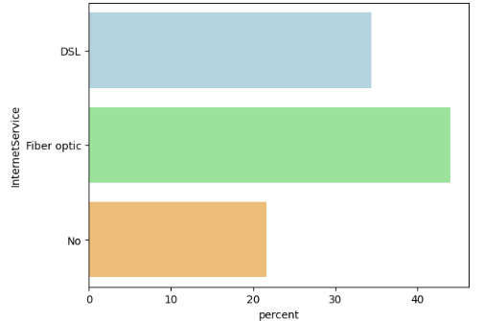
how many Internet Services we provide in our company? - list names and ratio please

Slide 19
03
Business Insights

Slide 20
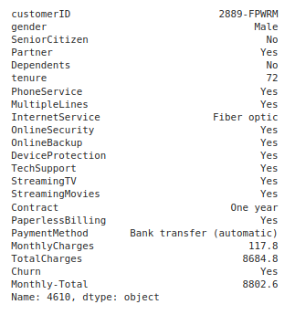
Most Important Customers
Identify high-value customers based on MonthlyCharges and TotalCharges.

Slide 21
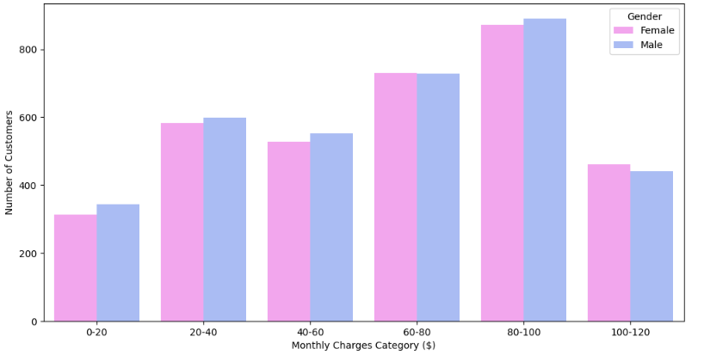
Distribution of Monthly Charges Categories by Gender

Slide 22
04
Conclusions

Slide 23



Conclusions
1-Tenure's Impact on Churn:
Customers with longer tenure are less likely to churn. This suggests that customer loyalty increases over time, and retaining customers beyond their initial months is crucial.
2-Contract Type Significantly Affects Churn:
Month-to-Month Contracts: The highest churn rate (42.7%) indicates that customers with more flexible contracts are more likely to leave. This might be due to the lack of commitment or the appeal of competitive offers from other providers.
Long-Term Contracts: Customers on one- and two-year contracts show significantly lower churn rates (11.3% and 2.8%, respectively). Long-term contracts help secure customer retention.

Slide 24
05
Recommendations

Slide 25
Recommendations
1-Promote Long-Term Contracts:
Trategy: Incentivize customers to switch from month-to-month plans to longer-term contracts (one or two years) by offering discounts, bundled services, or loyalty rewards.
Rationale: Long-term contracts are associated with significantly lower churn rates, securing customer retention over extended periods.
2-Address High Monthly Charges:
Strategy: Implement targeted offers for customers with high monthly charges, such as personalized discounts, loyalty programs, or value-added services.
Rationale: Customers with higher monthly charges are more likely to churn. Providing them with additional value or cost savings can improve satisfaction and reduce their likelihood of leaving.

